Slide 1
Lec - 3

Slide 2

OBJECT AT INFINITY
A
1 cm
C
F
P
1 cm
B
Position of Image :
At infinity
Nature of Image :
Real
Inverted
(C) Highly Diminished

Slide 3
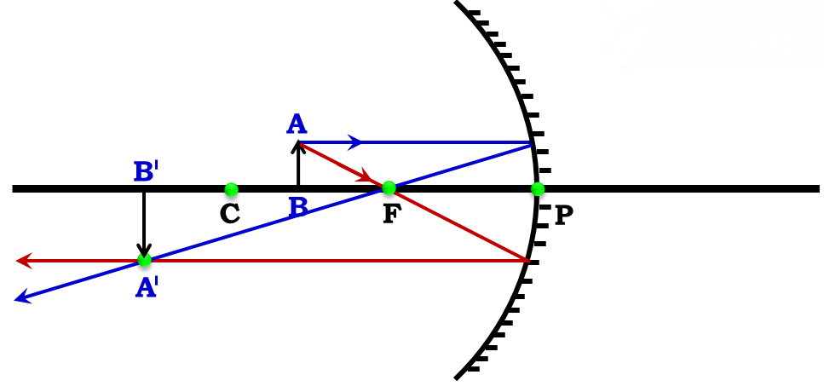
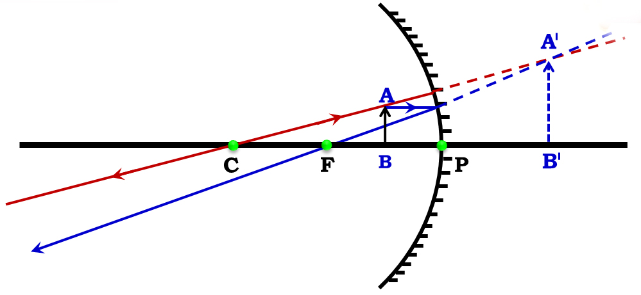
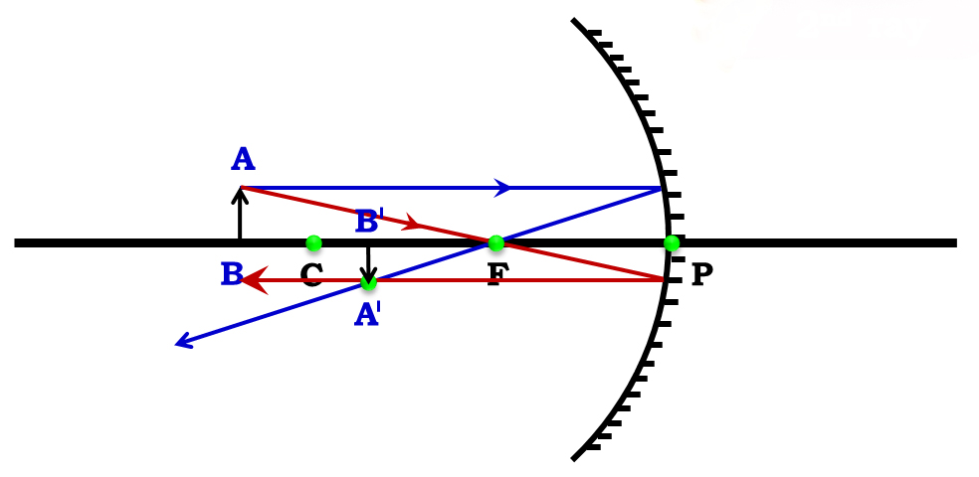
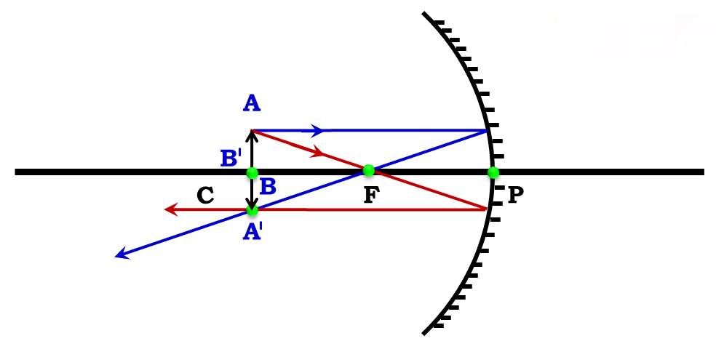
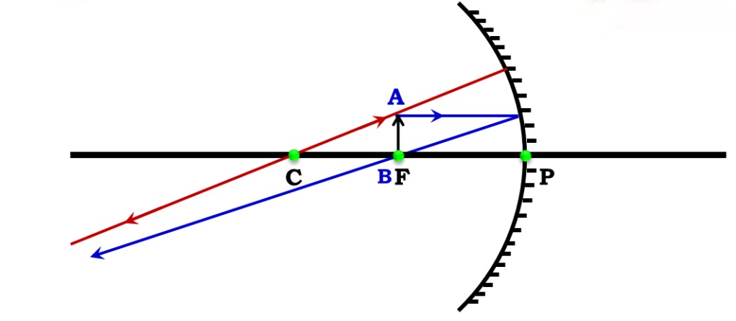
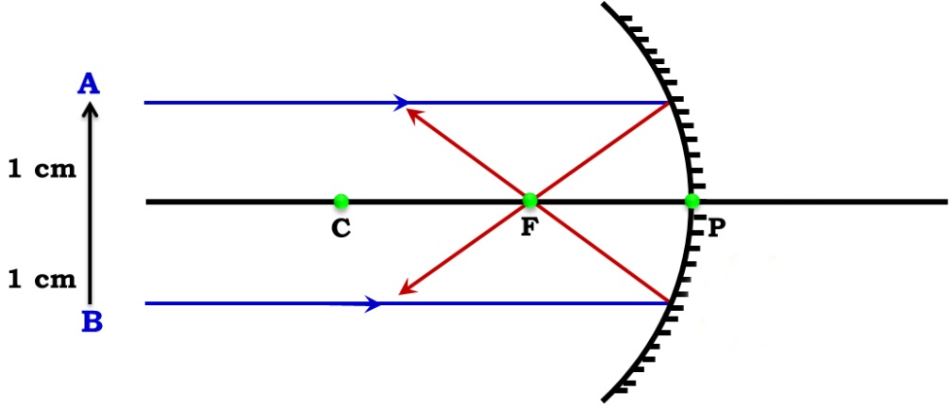
Position of object
Position of image
Size of image
Nature of image
At infinity
At focus F
Highly diminished
Real & inverted
REVISE ALL LENS RAY DIAGRAMS IN 3 MINUTES
At focus F
At infinity
Highly diminished
Real & inverted
Beyond C
Between F & C
Diminished
Real & inverted
Between F & C
Beyond C
Magnified
Real & inverted
At C
At C
Same size
Real & inverted
Between P and F
Behind the mirror
Magnified
Virtual & erect

Slide 4

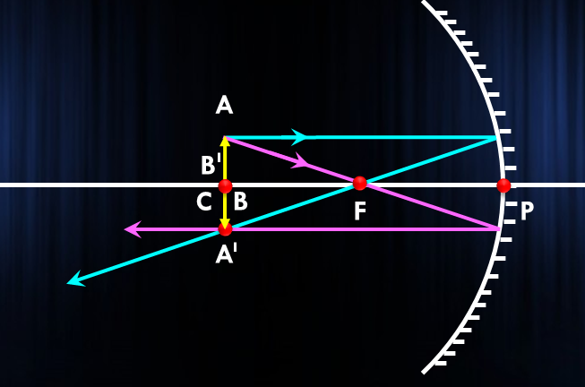
A concave mirror has a focal length of 10 cm. Where should an object be placed in front of this concave mirror so as to obtain an image which is real, inverted and same size as the object ?
1
Given :
The image formed by a concave mirror is real, inverted and of the same size, then the object must be placed at its centre of curvature (C)
f = 10cm
To Find :
Centre of curvature (C) = ?
Formula :
C = 2f
Solution :
C = 2 × f
C = 2 × 10
C = 20
Thus, the object should be placed at a distance of 20 cm in front of this concave mirror.
∴ C = 20 cm

Slide 5


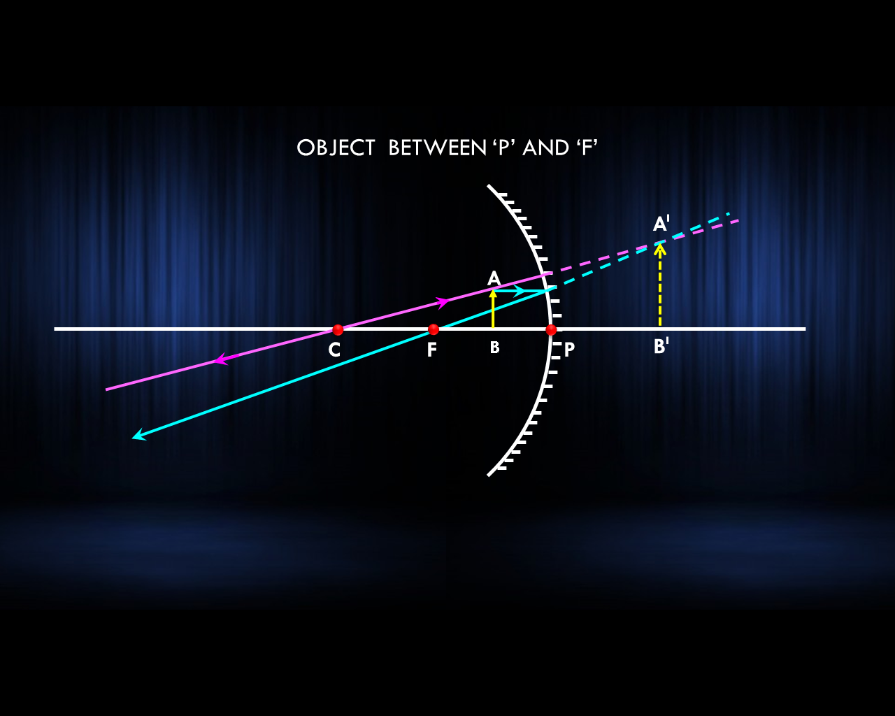
We wish to obtain an erect image of an object using a concave mirror of focal length 15 cm.
(a) What should be the range of distance of the object from the mirror?
(b) What is the nature of the image?
(c) Is the image larger or smaller than the object?
(d) Draw a ray-diagram to show the image formation in this case.
Q.
Ans.
d)
In order to obtain an erect image of an object with a concave mirror, the object should be at a distance less than its focal length. Here the focal length of concave mirror is 15 cm. The object should be placed at any distance which is less than 15 cm from the mirror.
The nature of image will be virtual and erect.
The image will be larger than the object.

Slide 6
Sunita takes a mirror which is depressed at the centre and mounts it on a mirror stand. An erect and enlarged image of her face is formed. She places the mirror on a stand along a meter scale at 15 cm mark. In front of this mirror, she mounts a white screen and moves it back and forth along the meter scale till a sharp, well defined inverted image of a distant tree is formed on the screen at 35 cm mark.
(i) Name the mirror and find its focal length.
(ii) Why does Sunita get sharp image of the distant building at 35 cm mark?
Q.
Ans.
(i) Concave mirror; f = 35 – 15
= 20 cm
(ii) Because the incident rays parallel to each other, after reflection from concave mirror, meet at focus and produce sharp image at focus.

Slide 7
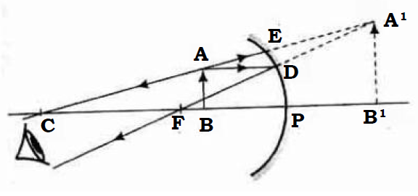
Q.
From the given table, showing object distance and focal length of three concave mirrors, answer the following questions.
Sr. No. | Object distance (cm) | Focal length (cm)
1 | 30 | 20
2 | 10 | 15
3 | 20 | 10
(i) Out of three, in which case, the mirror will form the image having same size as an object?
(ii) Draw the ray diagram for Sr. No.(2)
Ans.
(i) The mirror will form an image of same size as that of object in case 3.
(ii)

Slide 8

USES OF A
CONCAVE MIRROR
1. Concave mirrors are commonly used in torches, search – lights and vehicles headlights to get powerful parallel beams of light.
2. Concave mirrors are used as shaving mirrors to see a larger image of the face.
3. The dentists used concave mirrors to see large images of the teeth.
4. Large concave mirrors are used to concentrate sunlight to produce heat in solar furnaces.
5. Concave mirrors are used in doctor’s head mirror to concentrate the light beam on a small area of the body part such as nose, throat, ear, teeth, to be examined

Slide 9
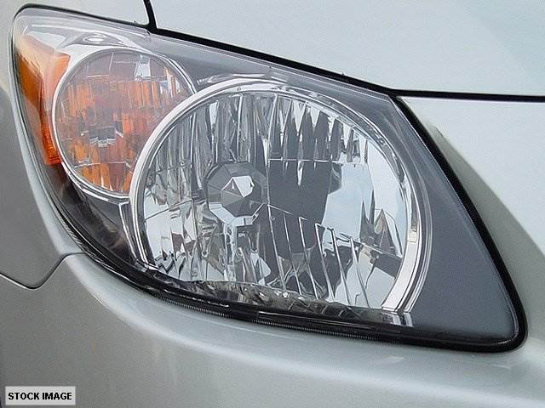
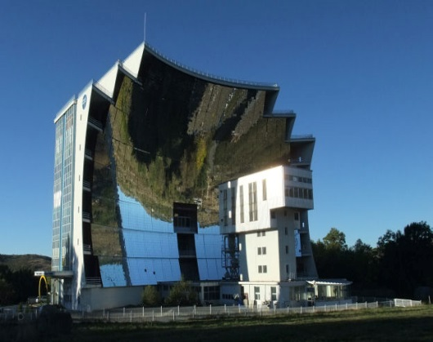
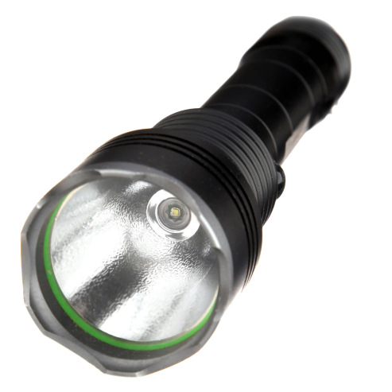
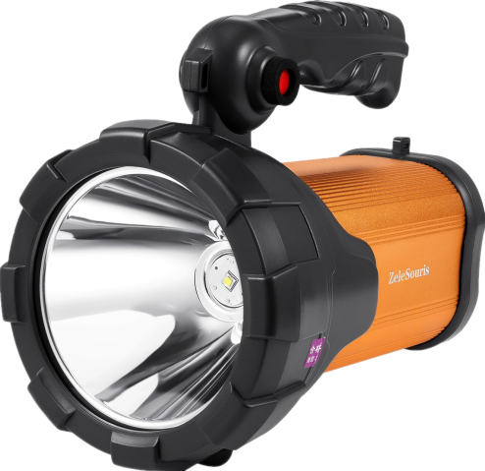



Uses of a concave mirror
search – lights
Concave mirrors are commonly used in torches, search – lights and vehicles headlights to get powerful parallel beams of light.
torches
1
vehicles headlights
Concave mirrors are used as shaving mirrors to see a larger image of the face.
2
3
The dentists used concave mirrors to see large images of the teeth.
Large concave mirrors are used to concentrate sunlight to produce heat in solar furnaces.
4
Concave mirrors are used in doctor’s head mirror to concentrate the light beam on a small area of the body part such as nose, throat, ear, teeth, to be examined
5

Slide 10

RAY DIAGRAM
RULES FOR MAKING RAY DIAGRAMS
RULE
A ray of light which is parallel to the principal axis of a convex mirror, appears to diverge from the focus after reflection from the mirror.
1
A
3 cm
2 cm
2 cm
B
P
F
C

Slide 11
RAY DIAGRAM
RULES FOR MAKING RAY DIAGRAMS
RULE
A ray directed in the direction of the centre of curvature of a convex mirror, is reflected back along the same path.
2
A
3 cm
2 cm
2 cm
B
P
F
C

Slide 12
RAY DIAGRAM
RULES FOR MAKING RAY DIAGRAMS
RULE
3
A ray which is directed towards the principal focus of a convex mirror, becomes parallel to the principal axis after reflection.
A
3 cm
2 cm
2 cm
B
P
F
C

Slide 13
RAY DIAGRAM
RULES FOR MAKING RAY DIAGRAMS
RULE
A ray of light which is incident at the pole of a convex mirror, is reflected back making the same angle with the principal axis.
4
A
i
B
r
P
F
C

Slide 14
OBJECT AT INFINITY OF A CONVEX MIRROR
A
2
2
P
F
C
B
Position of Image :
At F
Nature of Image :
Virtual
Erect
(C) Highly Diminished

Slide 15
OBJECT BETWEEN INFINITY AND P OF A CONVEX MIRROR
A
A
B
P
B
F
C
Position of Image :
At F
Nature of Image :
Virtual
Erect
(C) Diminished

Slide 16

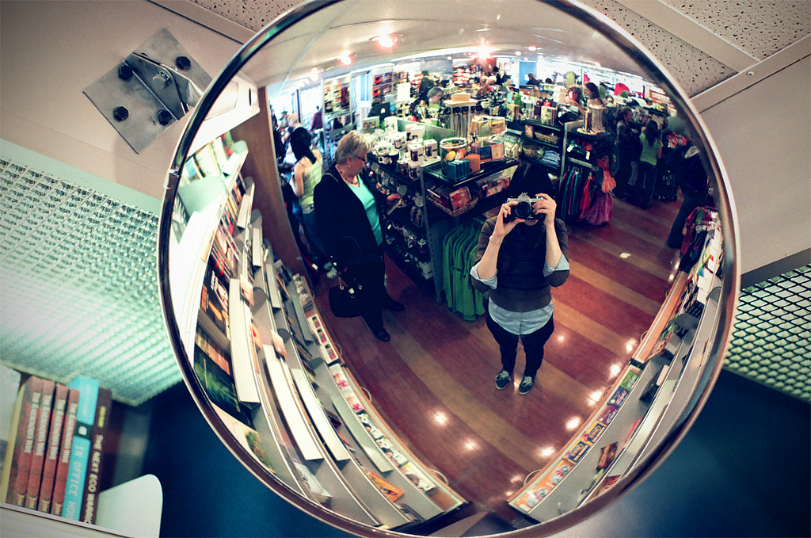
USES OF A
CONVEX MIRROR
SHOP SECURITY
MIRROR
REAR VIEW
MIRROR
1. Convex mirror is used as a rear view mirror in vehicles.
2. Big convex mirror are used as shop security mirrors

Slide 17
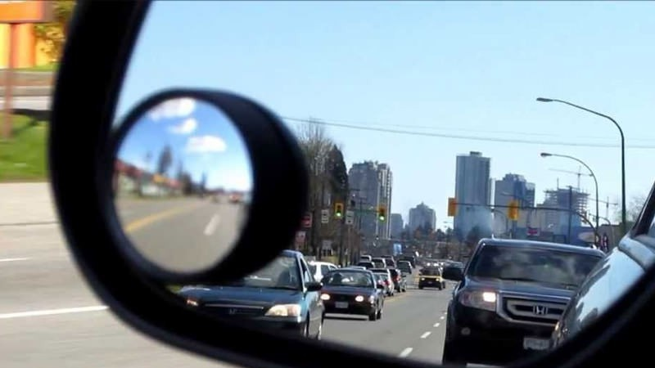

Why is convex mirror used as rear - view mirror in vehicles ?
CONVEX MIRROR
PLANE MIRROR
Wild field of view
Narrow field of view
The image formed in a convex mirror is diminished due to which a convex mirror gives a wide field of view
On the other hand a plane mirror gives a narrow field of view

Slide 18
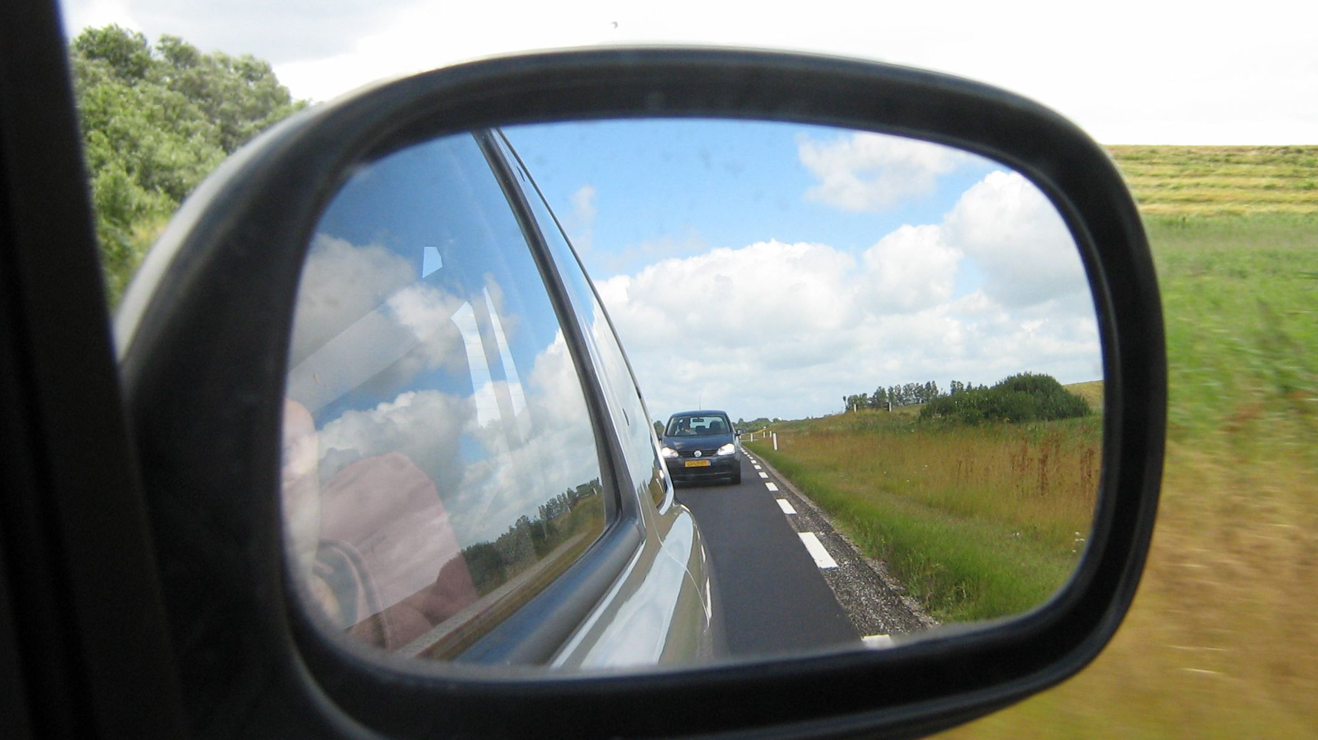
Why is convex mirror used as rear - view mirror in vehicles?
Concave mirror cannot be used in vehicles because it produces inverted images of distant object

Slide 19
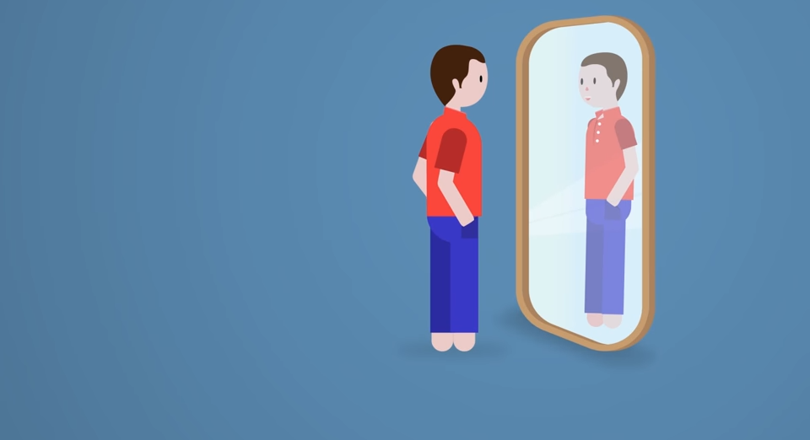
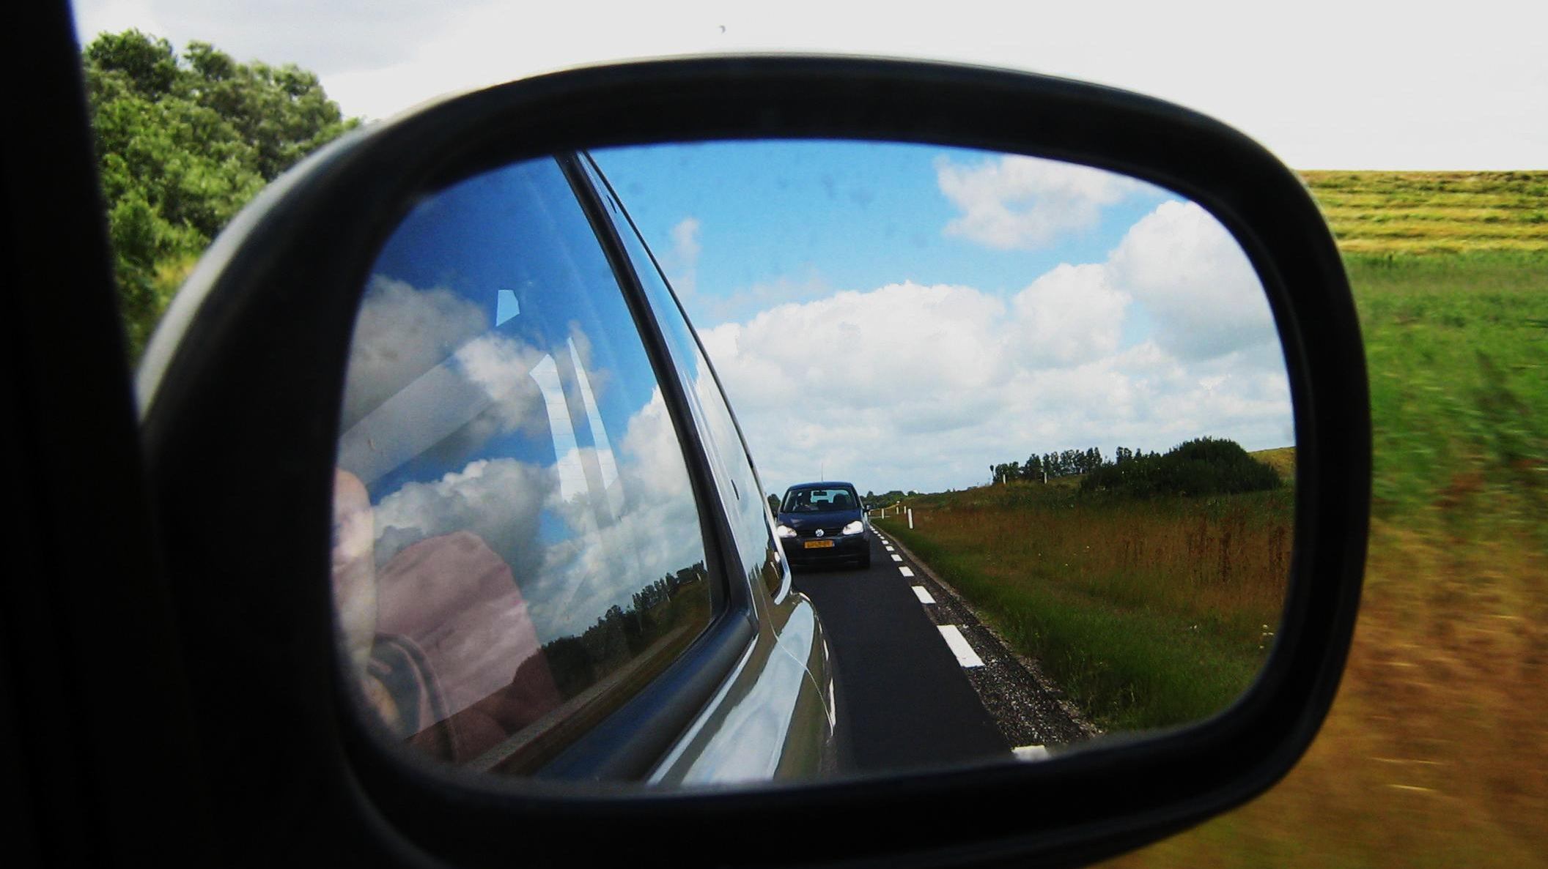
No matter how far you stand from a mirror, your image appears erect. The mirror may be
OBJECT
IMAGE
Concave mirror produces erect images only if the object is placed within the focal length.
Plane mirror always produces an erect image independent of the distance where the object is placed.
A
Convex mirror produces erect image of distant objects.
(A) Plane (B) concave (C) Convex (D) Either plane or convex
A
C
F
B
P
B
Both plane and convex mirror produce erect images of distant objects.
PLANE MIRROR

Slide 20
Q. Name a mirror that can give an erect and enlarged image of an object.
Ans : Concave mirror gives an erect and an enlarged image, when the object is between the pole and principal focus.

Slide 21
Thank You

